Slide 1




Horizon x DeVry
STRATEGIC AUDIT
May 2026
Notes:
KATIE
Thanks for the time today
We’re going to walk the team through our strategic audit of DeVry and what the implications are at a high level with a nod to tactical execution

Slide 2

WHY WE’RE
HERE TODAY
We’re here to assess the industry landscape, competitive benchmarks, and DeVry’s current site performance to identify the most impactful opportunities to strengthen the customer journey, improve conversion, and align on the priority actions & path forward coming out of the audit.
Notes:
Will
Today is about sharing the audit, but also aligning on what comes out of it
We looked beyond individual tests to assess the broader journey, where friction exists, and where the largest opportunities sit
The goal is not just findings for findings’ sake
It is to use those findings to align on priority actions now and the broader path forward from here

Slide 3
What We’ll Cover
Audit Approach
Assessment + Findings
Align on the highest-priority optimization pillars, near term bridge actions, and the path forward
Goal
Bridge Plan:
Priority Modules & Quick Hits Now
Path Forward: Roadmap & Execution
HORIZON COMMERCE ⎪ 3
Notes:
Will
We’ll first show how we approached the audit and what it surfaced
Then we’ll move from findings into action, starting with the bridge plan and the near-term concepts we think are ready to activate
Finally, we’ll talk about the path forward from there, both immediately and over the longer term
So the real goal is alignment on the biggest opportunities, the near-term bridge plan, and how to move from audit to execution

Slide 4
Our End-to-End Approach for Unlocking Conversion Growth
Goals and KPIs | External Assessment | Internal Performance Assessment | DeVry Program Pillar Creation | Test Concepting & Road Mapping
Confirm primary conversion goals and funnel definitions (visit to inquiry, inquiry to next action). Align on success metrics and guardrails by stage (engagement, form progression, completion, lead quality proxies). Flag measurement dependencies that affect readouts and testing. | Evaluate against industry trends, shifts in consumer behavior & emerging best practices Assess consumer sentiment through social listening Benchmark Devry experience against core competitors | Analyze performance by area of study and program where available. Review mobile vs desktop behavior and conversion gaps. Assess form progression and drop-off points, including visibility and usability issues. | Outline test ideas based on audit findings Identify consensus problems as strategic pillars for optimization | Prioritize ideas, collaboratively refine them through joint brainstorming Build a finalized pipeline based on impact, dependencies, & scope
Notes:
Will
We looked at this end-to-end, starting with goals and priority KPIs (V2I & I2A, etc.)
Then external landscape which we know was of particular interest
Internal performance, and how that translates into optimization priorities
The intent is to make sure the recommendations are connected,
And all this auditing led to optimization pillars based on which buckets the opportunities fall into
And you’ll see the findings section organized in that way
And lastly the test concepts. Typically this runs directly into a prioritized roadmap and testing pipeline. Today we have initial lower lift concepts which we’d propose bridge us til June
So we keep momentum

Slide 5
Strategic Audit Uncovers Impactful & Testable Opportunities To Drive Growth With Clear Execution Path
Capture Interest
Form Engagement Rate:
Evaluates success at generating initial interest
Area Of Study Engagement Rate: Evaluates ability generate interest in specific topics / programs
Revenue Growth
Convert Intent
Visit to Inquiry (V2I)
Evaluates legitimacy of initial interest
Inquiry to Appointment (I2A)
Evaluates ability to sustain and build on engagement for an easier sales experience
Notes:
Will
This slide anchors the audit in funnel stages
We looked at where there is opportunity to better capture interest, convert intent, and support revenue growth
So this is broader than just a form or content discussion

Slide 6
Journey Breakdowns Are Eroding Enrollment Opportunity
Lack of Information Hierarchy
Undecided visitors are lost before they ever reach proof or form intent
Unclear Value Props & Credibility
Users hesitate because trust and payoff aren’t earned before the ask
Arduous Lead Capture
High-intent is getting stranded by friction and low-intent never gets nurtured into intent
No Lead Nurture Post-Inquiry
Downstream value remains under‑captured even after an inquiry is won
Notes:
ANDREW
So you’ll see that here – with the big takeaway being that the opportunity clusters into four main areas:
1. Information delivery at the granularity of user needs with access to more specific information as users progress
2. Clearer value propositions based on what prospective students care about most
3. Resolving lead capture friction around more complex fields, inclusive of data-backed solutions beyond UX
4. Post-inquiry support to improve lead experience after inquiry, lead quality, and DeVry’s ability to prioritize high intent leads

Slide 7
Benchmarking DeVry By Pillar: Today & Potential After 1 Year
01
02
03
04
Information Hierarchy
Value Props & Credibility
Lead Capture
Lead Nurture
• Topic discovery content (Basic)
• Topic-based pathing (Basic)
• Program-specific content (Moderate)
• Program pathing (Moderate)
• Outcome pathing (Moderate)
• Recommendations (Sophisticated)
• Guided journeys (Sophisticated)
• Online modality (Basic)
• Stackable pathways (Basic)
• Career outcomes (Moderate)
• Cost transparency (Moderate)
• Tailored emphasis (Moderate)
• Value calculator (Sophisticated)
• Form urgency (Basic)
• Field filtering & pre-fill (Moderate)
• Mobile optimization (Moderate)
• Need-based inquiry (Sophisticated)
• Guided upper-funnel capture (Sophisticated)
• Positive consultation framing (Basic)
• Clear expectations (Basic)
• Post-inquiry freedom
(Moderate)
• Lead prioritization data (Sophisticated)
Score
Score
Score
Score
DeVry today
DeVry today
DeVry today
DeVry today
With optimizations
With optimizations
With optimizations
With optimizations
Industry
Industry
Industry
Industry
Doing well
Partial
Gap
Tactical implementations scored 1 – 5 and averaged for total score
Notes:
ANDREW
And what we’ve done here is just loosely scored where DeVry is at compared to competitors and where it could be after a year of focused testing
And on the next slides we’ll get into a bit more detail about these opportunities, why they matter and what DeVry can do about them

Slide 8

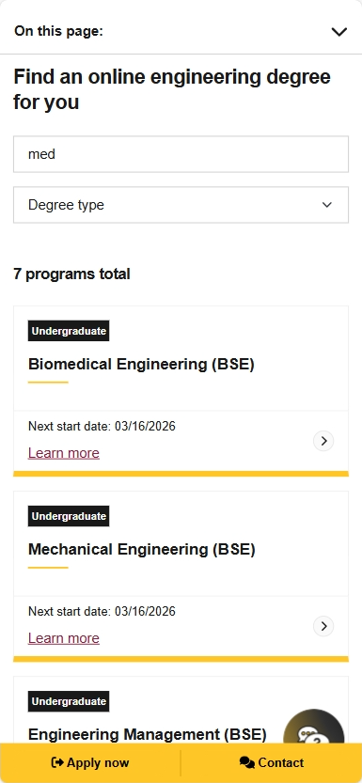
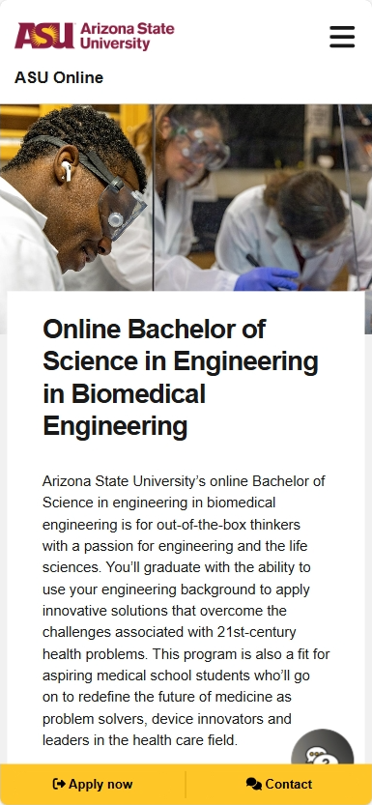
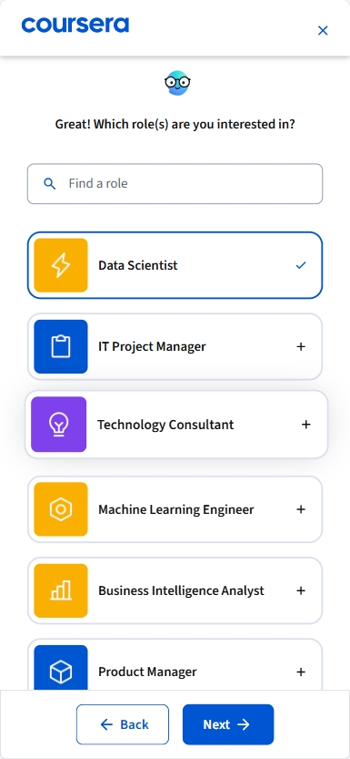
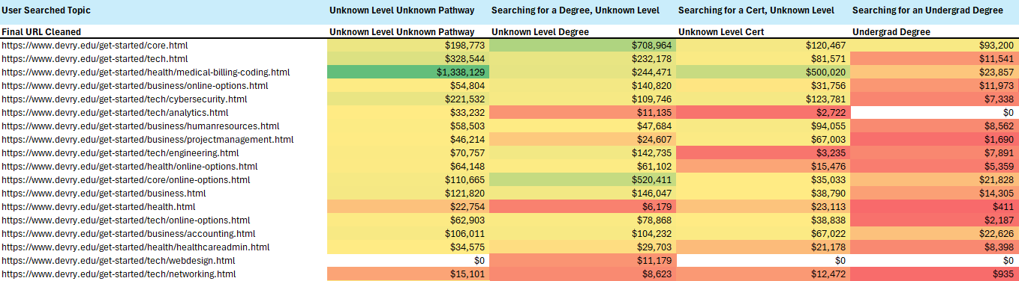
Information Hierarchy
Progressive Discovery Converts Undecided
Users Into Qualified Inquiries
Specificity Indicates Intent
Most Users Don’t Know What They Want (At First)
Competitors Guide Discovery, Rather than Gate It
When specific query intent matches landing page specificity, V2I improves by +44% and broad content for broad queries by +10% -- matching works, and specificity indicates intent
41% of paid spend targets queries without clear level or pathway - the experience then asks users to choose without specific context
ASU and Coursera use quiz-style pathfinders and topic → program flows to move undecided users toward specific programs without forcing premature decisions
+43% CVR
when specific
query → specific LP*
*2025 data on KWDs > $25 spend
Notes:
JORDAN
This section is about information hierarchy
Headline 1 is that when intent and landing experience are more closely matched, performance improves
So, broad queries still need broad pages like /core or /tech just like mid-level queries need topic-level but not program-level pages like /accounting
Headline 2 is that specific intent aligned to specific content is more valuable than broad intent aligned to broad content
We want to educate users to help them find the right topic and make that intent more program-specific, to get them ready to inquire, which is a common practice among competitors
That will send users who aren’t yet ready to inquire further down-funnel until they feel informed enough to inquire AND they will be doing so from a place of better understanding, better equipped to select the appropriate program and discuss with an enrollment consultant
Headline 3 majority of spend is broad
So, while we love our specific, targeted content, we do still need these broad pages
We just want to use them to path users down-funnel if they don’t feel ready to inquire yet

Slide 9
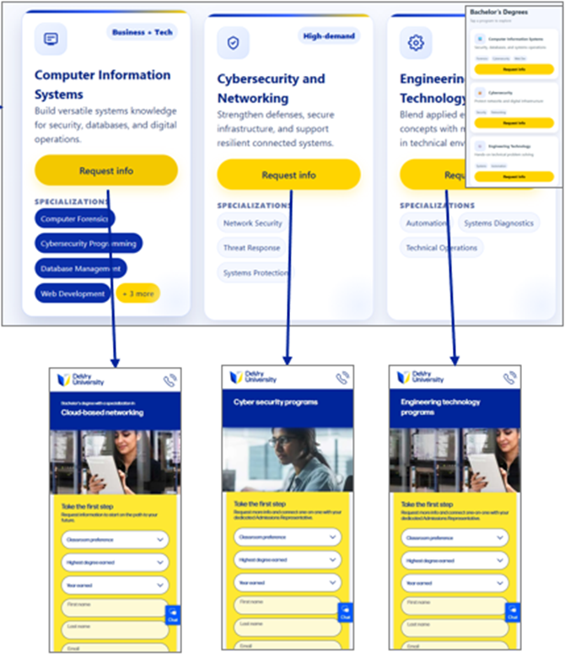
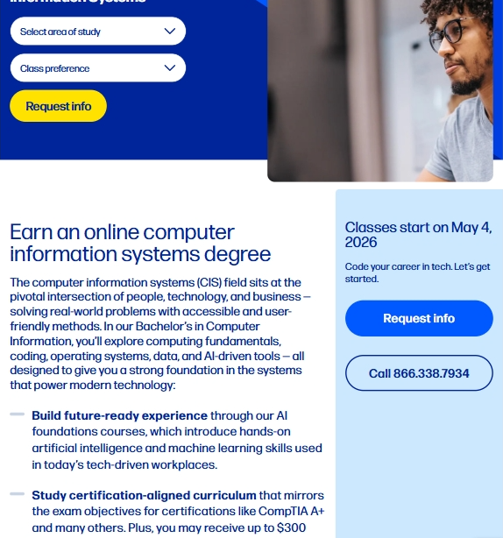
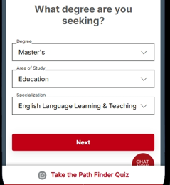
Information Hierarchy
Optimization Opportunities:
Topic & Career Goal Pathing Enable Progressive Discovery
PROGRESSIVE PATHING
Improved content discovery enables users to progress from high‑level interests to targeted programs, reducing friction through focused specialization paths and streamlined navigation
SPECIFIC PROGRAM DISCOVERY
Enabling user discovery all the way to their exact program of interest avoids halting exploration and produces high quality leads
GUIDED USER PATHS
Guided pathfinders reduce decision burden for undecided users, especially when decisions are put into user terms like role-based discovery
Notes:
JORDAN
The implication is that users need more support in discovering the right path
That could mean clearer topic pathing, eventual pathing to specific programs and even guided flows,
Things like linking to topics from the core page, recommending specific programs from the /analytics page or even creating need-based decisions like “what is your ideal job title?” or “Do you prefer to build technology or work with data?” all help users refine their intent not only for engagement data that can be analyzed and repurposed, but for themselves, so they feel more ready to inquire
The goal here is to get user intent at their current stage and help them shape that into a specific program if they don’t already know what they want. And if they do already know, help them get details about that program more easily to confirm that DeVry is in fact what they’re looking for.

Slide 10
Value Propositions & Credibility
Proof Must Earn Trust Before The Ask — Outcomes, Cost, And Flexibility Drive Enrollment
Career Outcomes Are The Primary Driver
Cost Clarity Is A Measurable Conversion Lever
Stackable Pathways + Online Modality Lower The Inquiry Barrier
Competitors make skills, tools, and outcomes easy to scan; DeVry does not yet provide the hands‑on proof, curriculum clarity, or employer cues tech users rely on to validate value and commit
Returning adults need early cost‑to‑value reassurance; competitors provide it up front, while DeVry delays tuition context—despite affordability page form delivering +43.9% higher completion rates
Students are **2.4x more likely to enroll when programs offer stackable credentials, yet despite 96% of DeVry inquiries preferring some online modality, this preference isn’t visually reinforced
*94%
of online learners enroll for career outcomes
17%
of DeVry Reddit posts discuss outcomes justifying cost
Affordability Page
+44% CVR
*Source **Source
Notes:
JORDAN
This section is about value propositions and credibility
Outcomes, cost & value, flexibility, and trust are central decision inputs for this audience
Right now there is room to bring those signals forward more clearly and earlier in the experience
94% of online learners enroll for career outcomes like job titles and expected salaries. If DeVry can’t demonstrate value for their prospective students, then 94% of users will not get the information they’re looking for, and you can see that in social media threads related to DeVry
Further, affordability transparency communicates trustworthiness AND let’s users make the decisions that are right for them. And we can see that on the affordability page, which has the highest form completion rate from start because users feel confident in their decision to move forward
Lastly, users want flexibility, and DeVry offers that. Confirming multiple modalities with an emphasis on online as well as the ability to use credentials partway through degrees while still stacking toward something more ideal or final is valuable information for prospective students that doesn’t live on get started

Slide 11
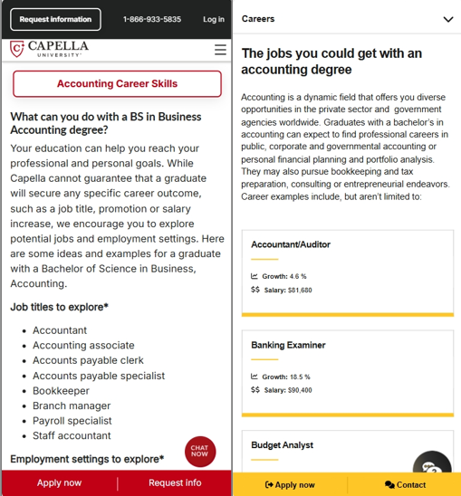
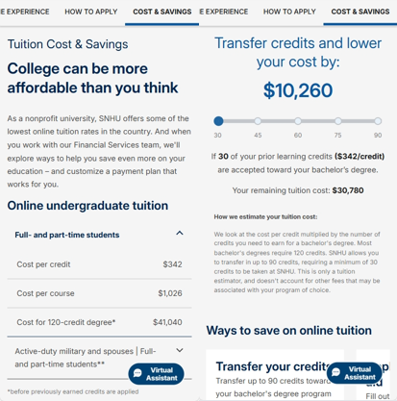


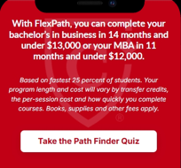
Value Propositions & Credibility
Optimization Opportunities:
New Modules Address User Concerns For High-Friction Decision
CAREER OUTCOMES SNAPSHOT
Career outcomes signal meaningful value aligned to user goals, making specific DeVry skills and outcomes more compelling than institutional attributes alone
COST + AID CLARITY
Pricing clarity builds confidence in decision‑making; higher education is inherently expensive, and hiding costs doesn’t change what users already know
STACKABLE PATHWAYS
Stackable pathways mitigate commitment & completion concerns and re-assure value as credits complete
ONLINE RE-ASSURANCE
Busy students prioritize flexibility in how, where, and when they learn, making online delivery an important value proposition to reinforce—even if it doesn’t drive modality selection
Notes:
JORDAN
This is really just the right modules in the right places to answer the concerns users actually have
Things like career outcomes, affordability and flexibility
Outcome snapshots, cost and aid calculators and flexibility confirmations all tell users that DeVry can meet their specific needs
These can be built into longer pages, hidden behind interaction or linked across the site, but moving to incorporate this information will be a long-term value-driver for DeVry’s marketing

Slide 12
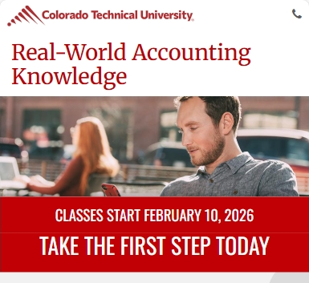
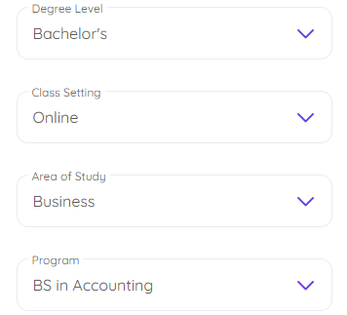
Lead Capture
A Condensed Form Places Urgency In View While Pathing Users Toward Desired Enrollment
Massive Mobile Form
Unknown Enrollment Dates
Difficult Form UX
A single step mobile form occupies substantial real estate and prevents users from engaging with content that takes them from awareness (query + click) to intent (inquiry)
“Every 8 weeks” allows delay while enrollment dates create urgency with deadlines
Competitors streamline selection with pre‑filtered, searchable dropdowns and focus on users’ desired degrees rather than past education
Mobile Inquiry Rate
(vs desktop)
-40%
Notes:
JORDAN
This section focuses on lead capture
The broad finding is that there is still friction at the point users are ready to act
That includes mobile experience, urgency, and ease of selection
The massive mobile form makes scrolling and engaging with other elements difficult. Also, asking for all that information at once is overwhelming and difficult to understand
“Every 8 weeks” enrollment date content removes urgency by making delay easy and not giving a concrete deadline
Lastly, and most importantly, difficult form UX makes the most important selections challenging and confusing.

Slide 13
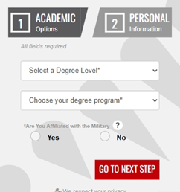

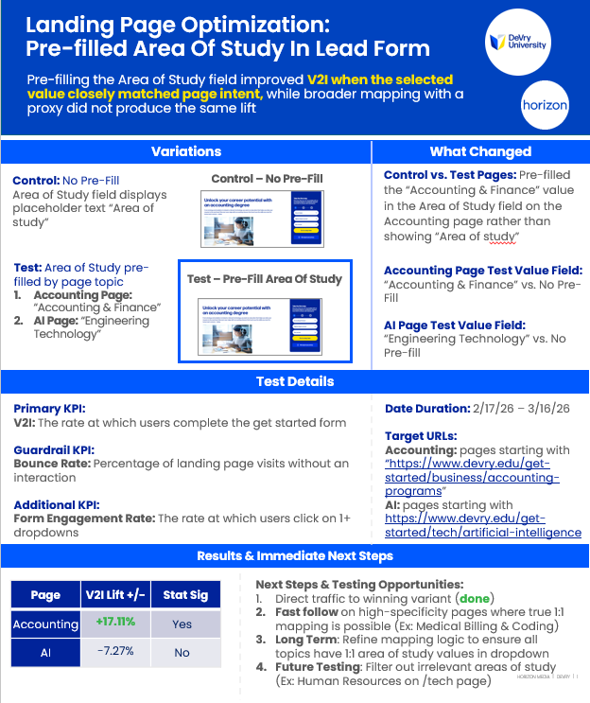
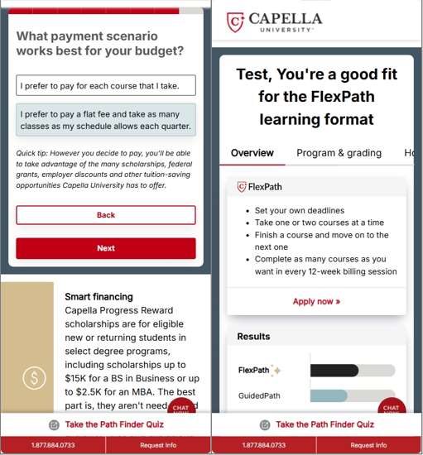
Lead Capture
Optimization Opportunities:
Testing Mobile Experiences to Reduce Friction at the Moment of Intent
MULTI-STEP MOBILE FORM
Multiple steps reduce overload and encourage scrolling for content engagement
ENROLLMENT DEADLINES
Enrollment deadlines create urgency and encourage immediate action from high intent search users
SMOOTH SELECTION
Program selection should focus on user intent—reducing effort with pre‑fill and search, and minimizing confusion through 1:1 field mapping and filtered, relevant programs
ALTERNATIVE FORMS
Forms that path users to appropriate programs via value exchange can capture leads for nurture ahead of inquiry
Notes:
JORDAN
The opportunity here is to reduce drop-off at the moment of conversion
That can mean better mobile patterns, stronger urgency cues, simpler selection or even alternative forms
Some things we’d really like to prioritize are related to smoother selection:
A program of interest field with values that map to DeVry’s promoted topics and programs
Pre-filtered lists to only show relevant options
Pre-filled values -- as possible
And form searchability
Those 4 updates would be massive for DeVry, and we already saw this play out with our pre-fill tests on Accounting and AI

Slide 14
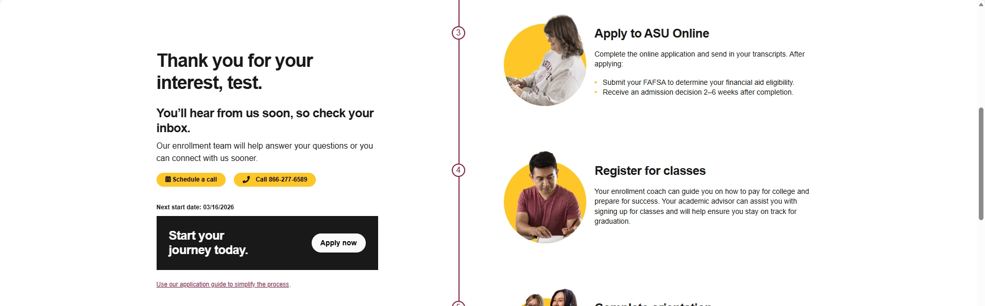
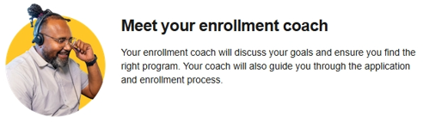
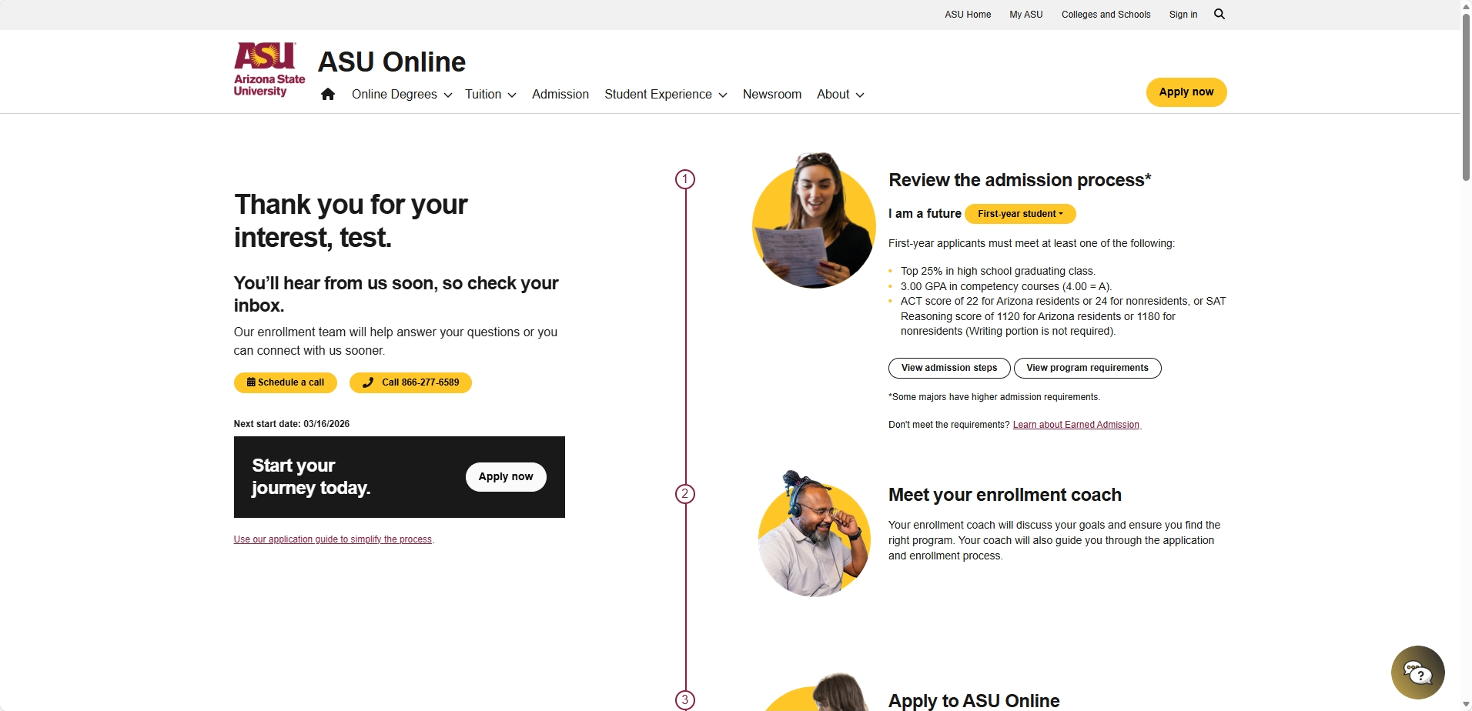

Lead Nurture
Enabling Continued Action Post Inquiry With Clear Next Steps Maintains Momentum
Immediate Action Limited To Outreach
Unclear Next Steps
Undesirable Phone Call
DeVry’s success page lacks clear enrollment steps, missing an opportunity to motivate students and set clear expectations for what comes next
Competitors streamline selection with pre‑filtered, searchable dropdowns and focus on users’ desired degrees rather than past education
Competitors immediately enable multiple next steps after lead capture (call, chat, apply online, or explore programs), while DeVry primarily pushes calls or chats without tailored content or an online apply path
0.3%
inbound calls or chat rate on get-started/thank you
23.2%
main site 2nd Inquiry Rate
Notes:
JORDAN
This section focuses on what happens after lead capture
Leads are clearly looking for more information, which is why almost a quarter of them fill out a 2nd inquiry, looking for a more serious application step
Promoting that online application and making more targeted program exploration easier would be a strong step in better serving completed inquiries
Further, providing clear next steps and expectations makes waiting for a phone call or even reaching out an easier action. Nobody wants to call some DeVry enrollment consultant if they don’t have a clear picture of what’s going to happen And WHY they should call or pick up the phone

Slide 15
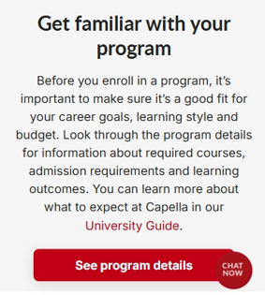
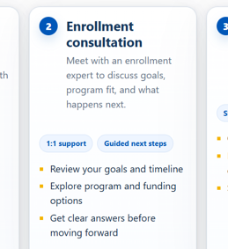
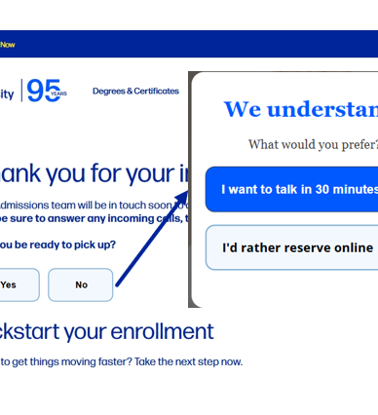
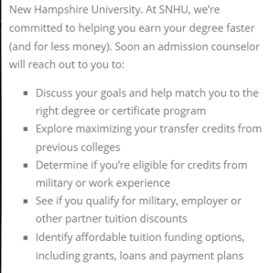
Lead Nurture
Optimization Opportunities:
Keep Leads Engaged & Clarify the Path Forward
ENCOURAGE EXPLORATION
Enrollment and tailored program exploration CTAs keep users engaged while they wait for a call
OUTLINE PROCESS
Outline enrollment process steps and make them feel manageable
PRIORITIZE WITH DATA
Use readiness data to signal where leads likely are in their journey, validate journey stage, and prioritize outbound dialers accordingly
RE-FRAME THE CALL
DeVry should clearly communicate the benefits of its enrollment concierge and position it as a value‑added support service—not just a process step
Notes:
JORDAN
So how do we do this?
We encourage users to explore further: view your program details, apply online, find what matters to you or what you want your next step to be (within DeVry’s prioritized set of course)
We tell users what they can expect and why the DeVry process works
We ask them where they’re at in their journey and use that to tailor content delivery and other actions
We re-frame the outbound call as a value-add to a prospective student
And that’s the set of opportunities that we would prioritize in DeVry’s current environment and with current infrastructure
All this gets high intent leads either applying online or on the phone more ready to enroll

Slide 16

Next Steps:
Modules & Quick Hit Tests
Notes:
So to this point we’ve focused on the audit findings
Now this section is the bridge plan – and the big idea here is to create continuity between whats already been proven and what gets scaled next
And capitalize on the opportunities we just talked about – at scale
Propose we start with concepts that are practical enough to launch now
What we want to validate is whether these feel like the right near-term priorities
And whether there is alignment on continuation to pursue them

Slide 17
Reusable Content Modules Map to 4 Experience Themes & Unlock Conversion Lift
Information hierarchy & progressive specificity
Guided Program Journeys
Role-Based Selection
How: Guide users to specific topics via quiz or self-selected list click
How: Assign programs to potential role outcomes and display accordingly
Value propositions and credibility
Career Outcomes Snapshot
Cost and Aid Snapshot
How: Skill & program lists with use of known brands as available
How: Up-front pricing with available affordability assistance
Streamlined lead capture
Form Usability (Mobile Emphasis)
Upcoming Enrollment Dates
How: Guided program selection and focus on education needs
How: Upcoming enrollment dates with urgency messaging
Lead nurture and post-inquiry action
Thank You Action Hub Next Action
Enrollment Process Details
How: Inbound conversion paths and recommended program exploration
How: Simple explanation of enrollment steps including phone consultation
Each module is testable in multiple templates/placements and can be prioritized by impact and effort.
Notes:
JORDAN
We want to create a sustainable, and constantly improving digital experience
And we believe these content modules are a solid visualization of changes applicable across templates for easy alignment, implementation and expansion. Like our pre-fill test on the accounting page which would be very easy to expand onto the medical billing & coding, analytics or other specific pages
The main idea here is modularity
Rather than treat every page as a separate exercise, there is an opportunity to identify reusable high-value components and create truly templatized pages (Likely 4 templates across Core, schools like tech or business, topics like accounting or engineering and programs like cybersecurity certification)
That gives us a clean bridge from testing into broad rollout for maximum impact

Slide 18
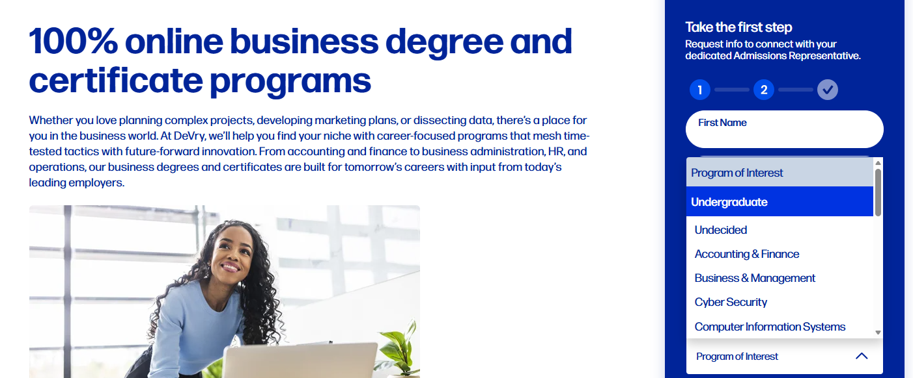
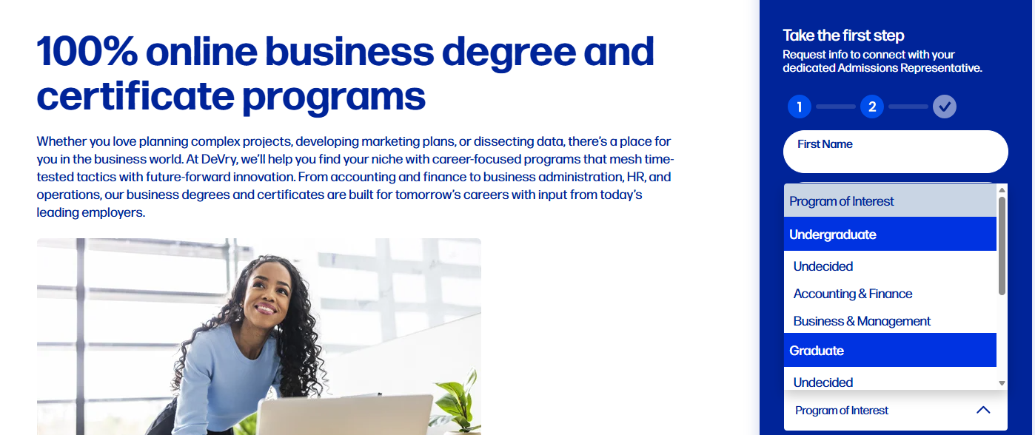
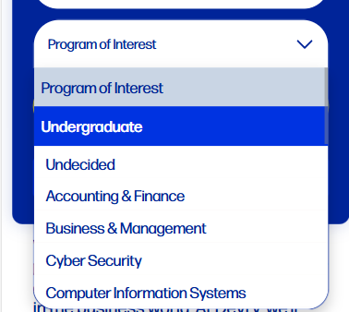
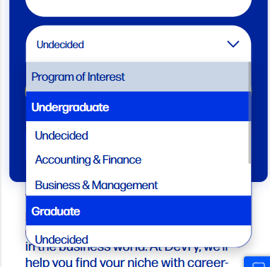
Filtered LP Dropdowns
Lead Capture
Week 0-2
Control
Experiment
Concept
Primary focus:
Filter dropdown values to only programs relevant to the landing page content (/business-programs example on the right)
Rationale:
This is a best practice live on GCU (Link)
Implementation is simple as it requires 1 line of CSS tied to relevant elements
Estimated 12M Impact If Winner: 252 Apps
Notes:
JORDAN
And this first concept is a great example.
We want to filter out irrelevant programs of interest, programs that are not part of the school that the current page relates to. This kind of concept is applicable across pages, is easy to implement and removes obvious friction from the form

Slide 19
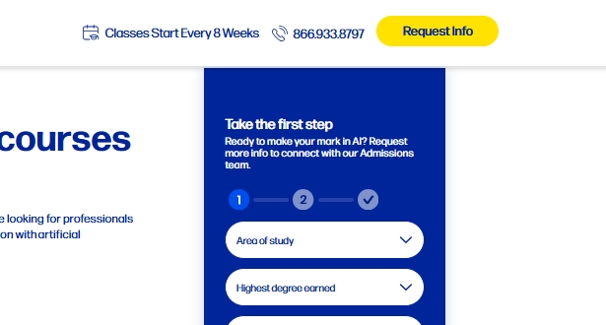
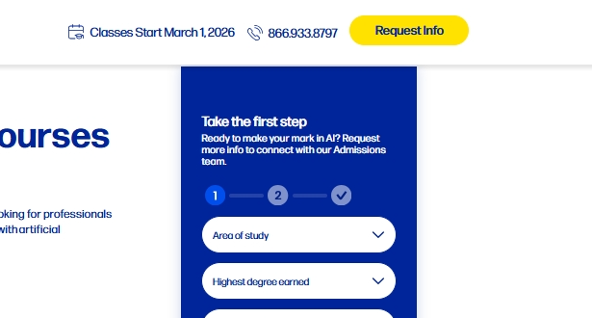
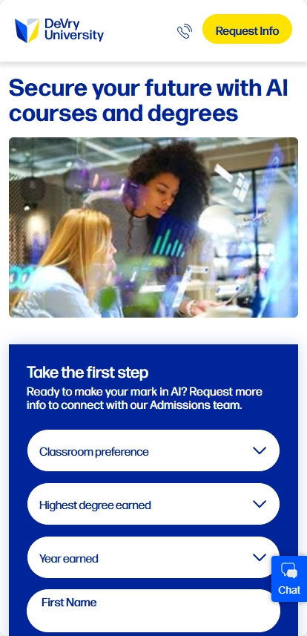
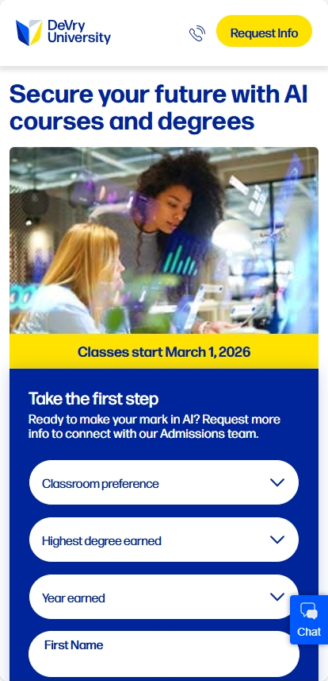
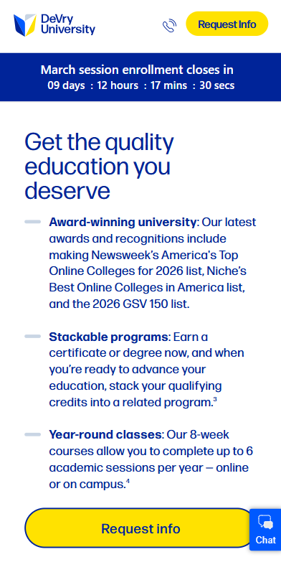
Enrollment Dates Create Urgency (ABC or Multivariate)
Lead Capture
Week 0-2
Control
Experiment
Concept
Primary focus:
Create enrollment urgency by communicating the next date classes start
Rationale:
Urgency is a commonly winning tactic across ecom and lead gen: Link
Colorado Tech uses clear enrollment dates to create urgency: Link
Copy changes and simple module insertions make concept low lift
Estimated 12M Impact If Winner:
125 Apps
Notes:
JORDAN
This concept is another very low lift experiment that would add some more urgency, which is especially valuable for high intent users like paid search clicks

Slide 20
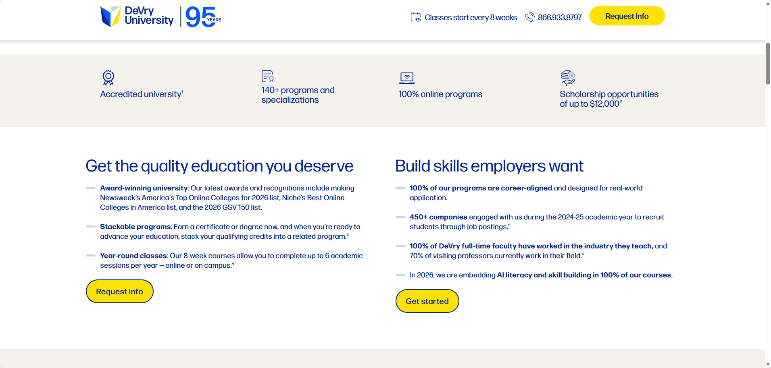





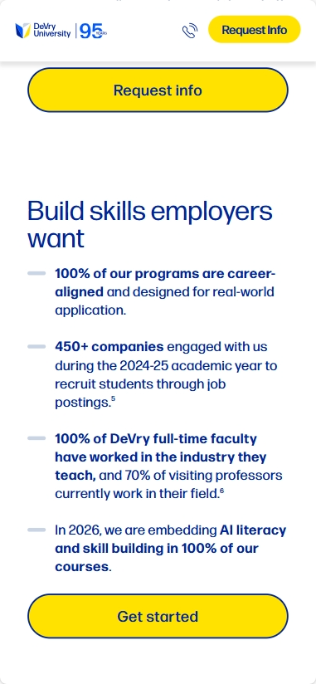
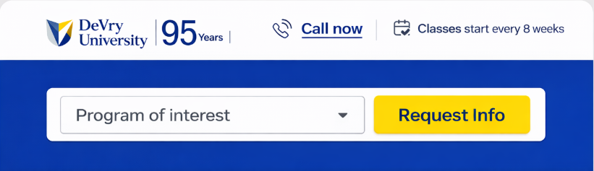


Sticky Product Intent Capture
Information Hierarchy
Concept
Week 0-2
Control
Experiment
Primary focus:
Enable users to convert at the moment of intent with a sticky CTA that includes program of interest capture
Ensure selection is passed as a pre-fill
ABC as an anchor link on current page or linking to more specific page
Rationale:
This is a winning concept from other clients (11% primary KPI lift)
Pre-selecting program of interest reduces requirements for engaging with a more complicated form
Estimated 12M Impact If Winner: 165 Apps
Notes:
JORDAN
And here we get a bit more into progressive pathing.
This allows us to:
Capture topic or program of interest data for use in this session, future sessions and even media if we can get the data right and
Make the first step standalone, so we breadcrumb form fill and make eventual completion easier
And while this test works across pages, we could even follow-up test different pathing by page type like testing School of interest (Tech, health or business) selection on Core landing page because as I’ve mentioned, testing is an ongoing process

Slide 21
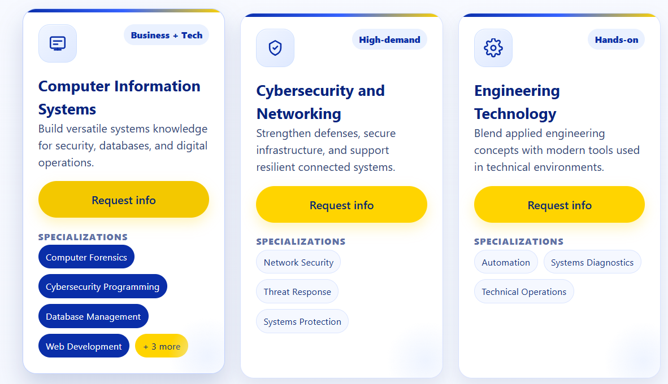
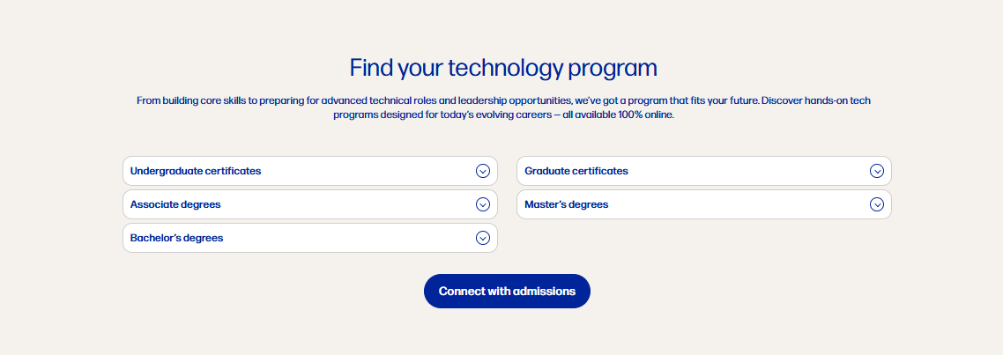
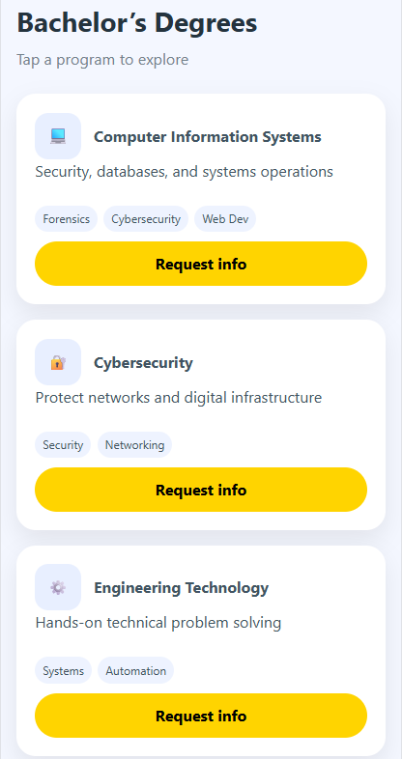
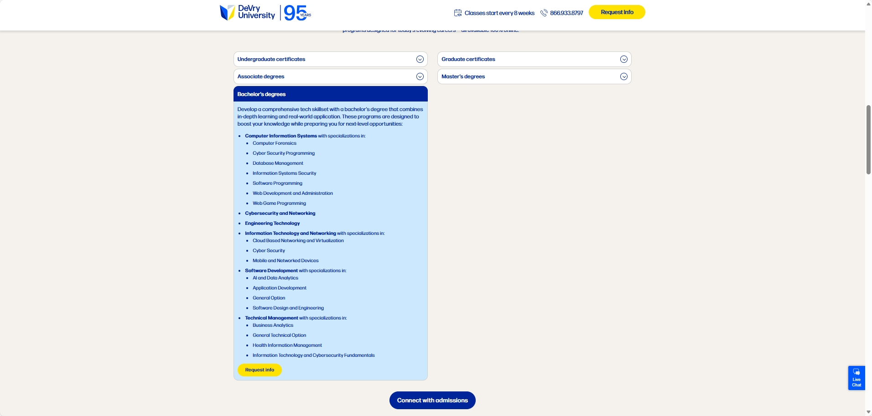
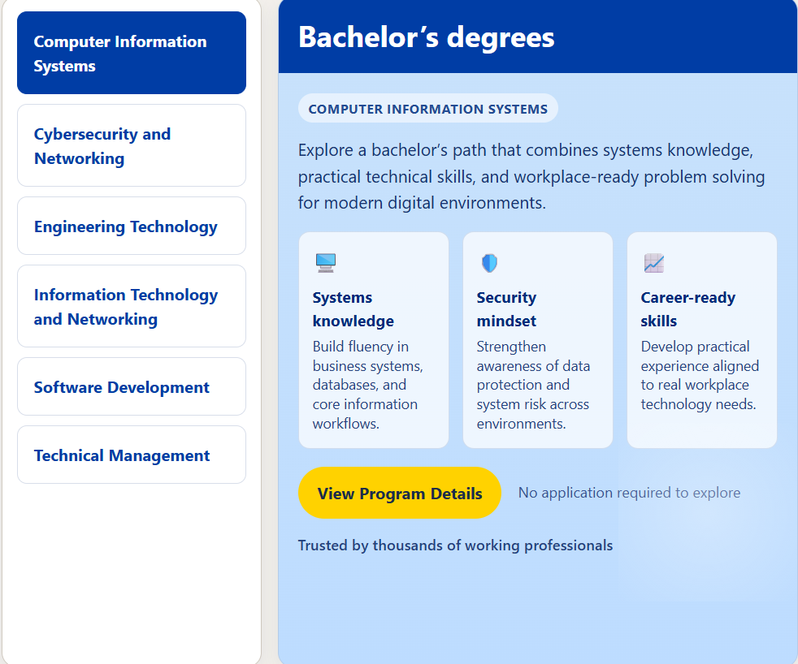
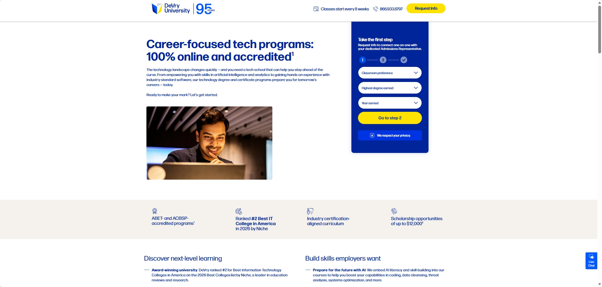
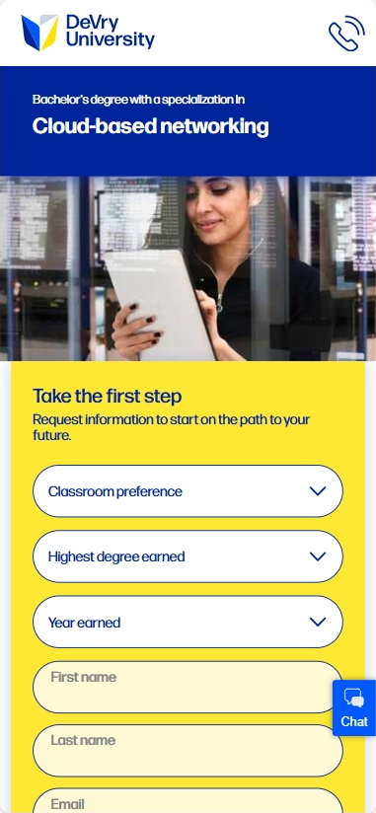
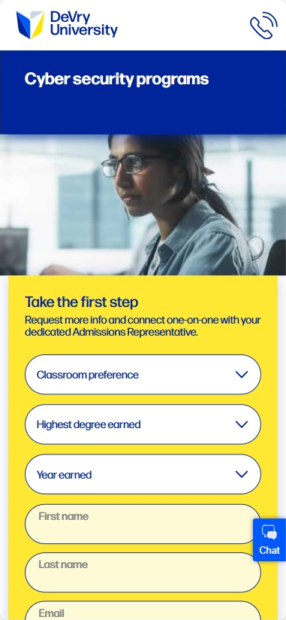
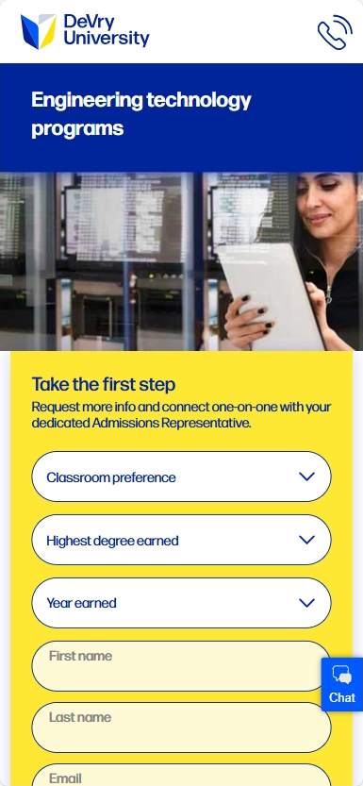
Content Progression Engages Researching Users
Information Hierarchy
Control
Experiment
Concept
Option 1 (reco)
Week 0-2
Primary focus:
On Higher level pages (Core, tech, business and health), link to the most relevant specific topic page to engage researching users in the upper funnel with progressive learning and avoid frustration and abandonment
Rationale:
Progressive specificity is in place on major competitors like ASU (Link), University of Phoenix (Link) in a similar hierarchy, Colorado State (Link) and Walden (Link)
Specific queries to specific LPs convert 44% better than specific queries to broad LPs
Estimated 12M Impact If Winner: 351 Apps
Option 2
Notes:
JORDAN
And here we have something a bit more substantial
The goal here is to path users to their exact program of interest. And we would even start by topic while tracking gets worked out, but it should be entirely possible to create pathing to the main site that directs to specific programs as users desire
https://designergpt.replit.app/pages/e7bf44c479c1a9bc12dea23226166ac6.html
https://designergpt.replit.app/pages/6b12d4f032511f282dd0e144e72df6ef.html#request
https://chatgpt.com/g/g-2Eo3NxuS7-designergpt/c/69d011de-ca74-8327-b3be-45e89afdd174

